Slide 1
Digitalization of Advance Care Planning A National and state-wide Landscape
Andrew Ikhyun Kim

Slide 2
Outline
Framework for ACP Digitalization
MA Landscape
National Landscape
State Vignettes: Maryland and Oregon
Emerging Themes

Slide 3
A Framework for ACP Digitalization
“I just went through the MOLST with my mother. I always wondered where it goes. Just like my HCP. How do I know they have it?”
Inputs
Content
Outputs

Slide 4
Inputs
Hayek et al, 2014
Who can input?
Concurrent training
Workflow integration

Slide 5
Content
Reliability
Legally Valid
Up to date
Flexibility to change
Relevance
Code Status (90%)
Durable Power of Attorney for Health Care (78%)
POLST/MOLST/POST (86%)
Living Will (37%)
Values History (31%)
Combined Directives (e.g. “Five Wishes”)
Lakin et al., 2016

Slide 6
Outputs
EMS/ED/nursing homes (‘end-users’)
(1) Timely access
(2) Accordance (strong requirements for validity)
Emergent
Urgent
Non-Urgent
Conversations with Kei Ouchi; Lakin et al, 2016

Slide 7
MA Landscape
Interview/analysis of 22 institutions across MA
Most widely used hospital and medical group EHRs:
EPIC, Cerner, Meditech, Allscripts
3 with ACP modules personalized into EHR
Most use scanned documents
Variable or poorly measured rates of digitalization

Slide 8
Details of four models
Institution | Scanned Documents | ACP Module | Utilization
Atrius |  |  | High risk patients: 90%+ HCP 75%+ MOLST
Partners |  |  | Inpatient only
Baystate |  | Partial Folder | Planning Pilot
Cambridge Health Alliance |  |  | Variable

Slide 9
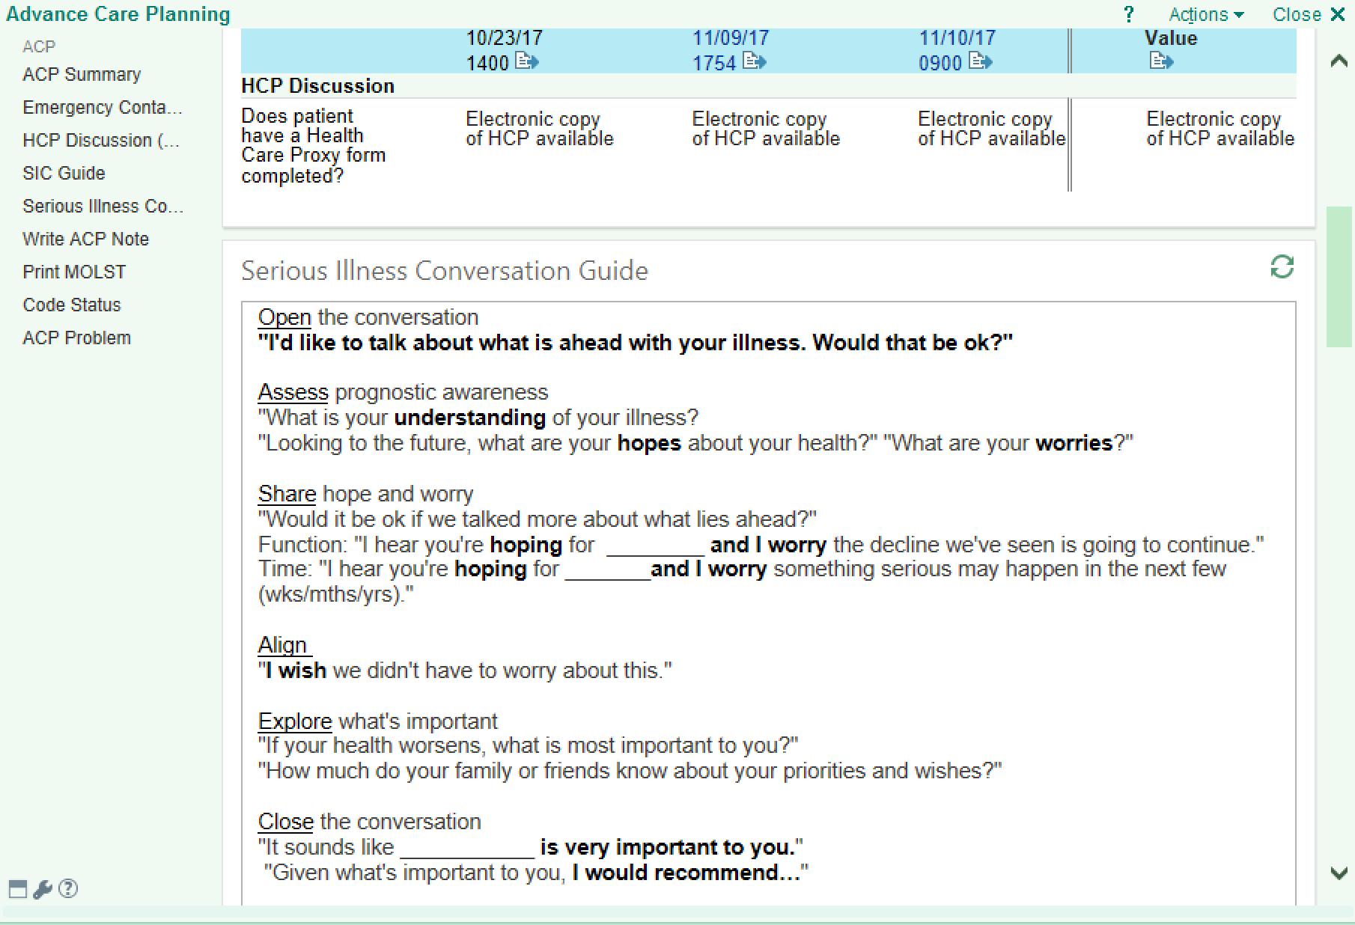
Example ACP Module: Partners

Slide 10
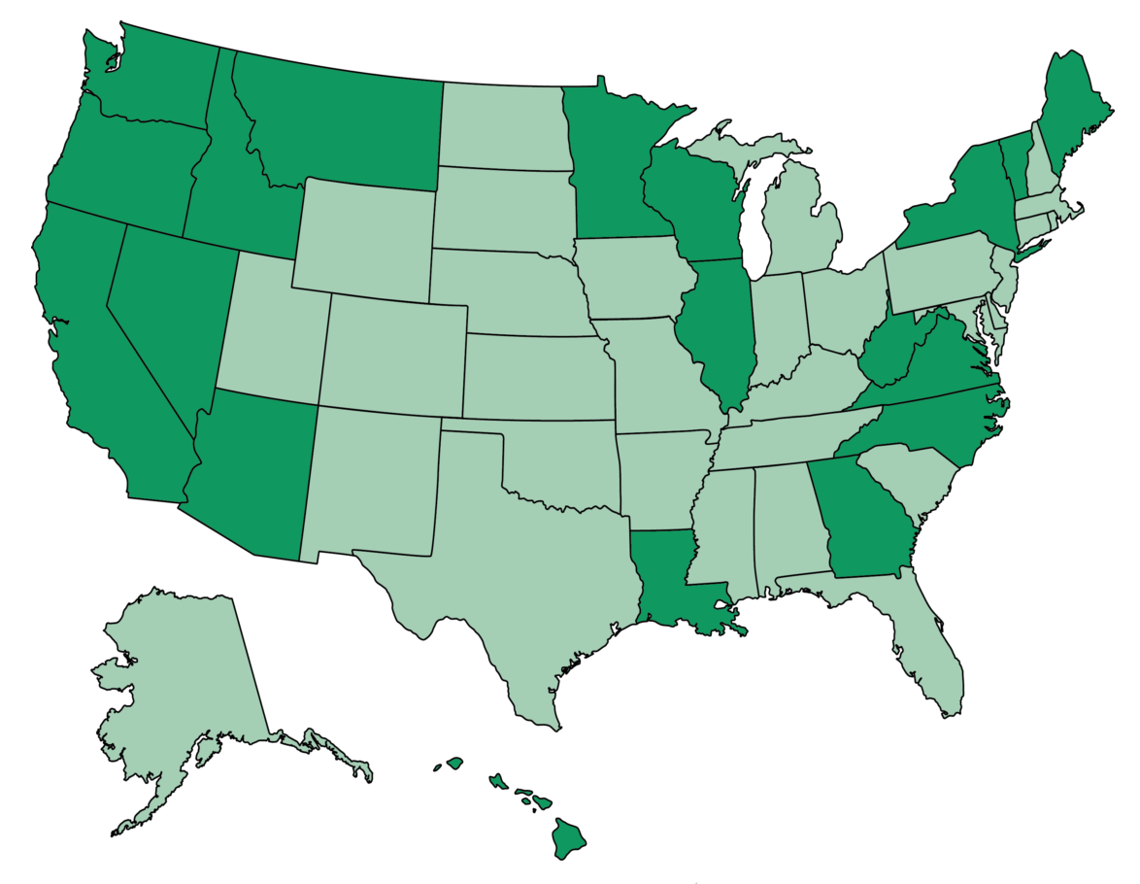
National Landscape
16 states with AD registries
5 with electronic submission
7 with POLST/MOLST Registries
10+ states contracted with a private registry/service
Vynca
MyDirectives
US Living Will Registry
Jacqueline Lampert
Dark Green: States with AD solutions

Slide 11
Maryland
Content: MyDirectives -> Any Document
Process:
Input: Multiple existing registries
Output: Provider only query
Volume: Low
Technology: MyDirectives -> home-grown record locator

Slide 12
Oregon
Content: POLST
Process:
Input: ePOLST + Scan + Fax
Output: Phone calls (53.2 seconds)
Volume: 3,500-5,000 uploads/mo; 108-165 calls/month; 42.8% match
Financial: $250,000 grant from health authority
Technology: Vynca; EPIC integrated

Slide 13
Emerging Themes
Ensure sufficient resources for training & outreach
Implement in multiple stages
Create a learning system with data analytics
Consider cost and cost savings
Legal considerations

Slide 14
“The document is not the solution.
The word ‘infrastructure’ set this in place for me. It’s like we need to create highways before training people to drive, to make sure that people get where they need to go.”
Mrs. N (BIDMC Patient Focus Group)

Slide 15
With Gratitude to:
Secretary Alice Bonner
The team at EOEA, MeHI, and MA Coalition for Serious Illness Care
Lachlan Forrow; Lauge Sokol-Hessner; Susan Mitchell
Kei Ouchi; Irene Yeh; Rachelle Bernacki; Terry O’Malley
Ellen Dipaola; Jennifer Connor; Diane Dietzen; Pat Noga; Steve Defossez
OHSU: Erik Fromme and Dana Zive
West Virginia: Woody Moss and Evan Falkenstine
Maryland: Ross Martin and Lindsey Ferris
Our RFI Responders
BIDMC PFAC Focus Group Participants

Slide 16
References
Woody Moss and Evan Finkelstine, West Virginia. Personal Communication. June 2017.
Dana Zive and Eric Fromme, Oregon. Personal Communication. June 2017.
Irene Yeh and Rachelle Bernacki, DFCI. Personal Communication. June 2017.
Lachlan Forrrow, BIDMC. Personal Communications. June 2017.
Kei Ouchi, BWH ED. Personal Communication. June 2017.
Grudzen CR, Buonocore P, Steinberg J, Ortiz JM, Richardson LD; AAHPM Research Committee Writing Group.. Concordance of Advance Care Plans With Inpatient Directives in the Electronic Medical Record for Older Patients Admitted From the Emergency Department. J Pain Symptom Manage. 2016 Apr;51(4):647-51
Lakin JR, Isaacs E, Sullivan E, Harris HA, McMahan RD, Sudore RL. Emergency Physicians' Experience with Advance Care Planning Documentation in the Electronic Medical Record: Useful, Needed, and Elusive. J Palliat Med. 2016 Jun;19(6):632-8. doi: 10.1089/jpm.2015.0486. Epub 2016 May 20
Zive, Dana M., and Terri A. Schmidt. Pathways to POLST Registry Development: Lessons Learned. Rep. National POLST Paradigm Task Force, Oct. 2012

Slide 17
References Continued
Hayek Salim, Nieva Ria, Corrigan Frank, Zhou Amy, Mudaliar Uma, Mays David, Massoomi Michael, and Ilksoy Nurcan. Journal of Palliative Medicine. December 2014, 17(12): 1348-1352
Lindner SA, Davoren JB, Vollmer A, Williams B, Landefeld CS. An electronic medical record intervention increased nursing home advance directive orders and documentation. J Am Geriatr Soc. 2007 Jul;55(7):1001-6.
Morrison RS, Olson E, Mertz KR, Meier DE. The Inaccessibility of Advance Directives on Transfer from Ambulatory to Acute Care Settings. JAMA . 1995;274:478-482
Olszewski, Newgard C, Zive D, Schmidt TA, McConnell KJ. Validation of Physician Orders for Life-Sustaining Treatment: Electronic Registry to Guide Emergency Care J Am Geriatr Soc. 2012 Jul; 60(7):1384-6.
Schmidt TA, Olzewski E, Zive D, Fromme E, Tolle SW: The Oregon POLST Registry: A Preliminary Study of EMS Utilization J Emerg Med (in press)
Wilson CJ, Newman J, Tapper S, Lai S, Cheng PH, Wu FM, Tai-Seale M. Multiple locations of advance care planning documentation in an electronic health record: are they easy to find? J Palliat Med. 2013 Sep;16(9):1089-94. doi: 10.1089/jpm.2012.0472. Epub 2013 Jun 6

